Slide 1
EDUCATION
Microsoft powerpoint

Slide 2
Microsoft power point:
How to start a presentation
Inserting shapes and icons
How to create bullets

Slide 3
HOW TO START PRESENTATION:
To start your slide show, on the Slide Show tab, select Play From Beginning. ...
To manage your slide show, go to the controls in the bottom-left corner and do any of the following: ...
To skip to any slide in the presentation, right-click the screen and select Go to Slide.

Slide 4
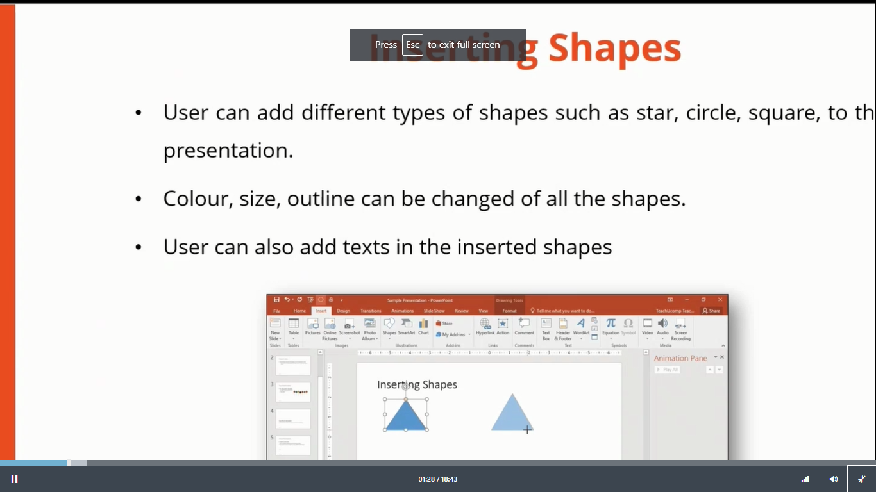
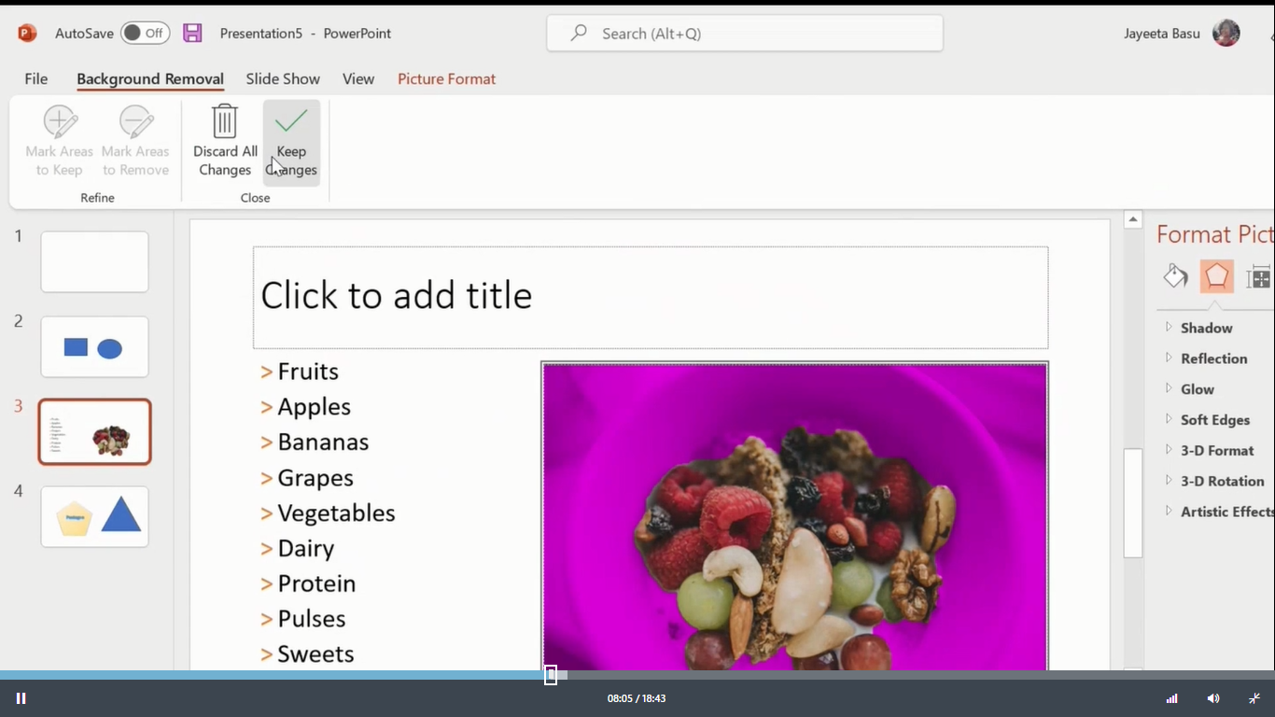
Insert shapes&icons:
Shapes:
Bullets:

Slide 5
Advantages of powerpoint presentation: 1. It can be used virtually anywhere
Put your presentation on a USB flash drive or in any cloud storage app and you will have your PowerPoint presentation at hand anytime. It is also included in standard professional settings, so with your user license, you can access your presentation from anywhere.
2. It is a collaborative solution
Work from home is now a normal thing to do. Tools that provide solutions for working together with your team even if you are in different locations are in high demand. PowerPoint adapted to this situation and with its online cloud storage, you can now work on presentations at the same time, or work on the same presentation without sending it to each other.

Slide 6
THANK YOU!

